Slide 1

Machine Learning–Driven Analysis of Pneumonia Patients
An Exploratory Study of Clinical Patterns, Vital Signs, and Patient Outcomes
- Pushpa Madhuri Garikiparthi
Notes:
Hello everyone. Welcome to my presentation titled Machine Learning–Driven Analysis of Pneumonia Patients. In this project, I analyzed pneumonia patient data using statistical techniques and machine learning methods. I focused on exploring vital sign patterns, applying PCA for dimensionality reduction, clustering patients into groups, and examining differences in survival outcomes. In the next slides, I will walk through the data, the methods used, and the key insights from the analysis

Slide 2
Data Imputation & Preprocessing
Handling Missing Data – Removed patients with more than 20% missing values – Imputed missing vital signs using the median
Statistical Checks Before Imputation – Tested vital signs for normality using the Shapiro–Wilk test – Since distributions were non-normal, used the Mann–Whitney U test for group comparisons
WBC-Specific Imputation – Categorized WBC into low, medium, and high groups – Applied stratified imputation within each category – Imputed missing WBC flag values based on category ranges
Notes:
Before starting the imputation process, I extracted the data from the PIC database using PostgreSQL. The vital signs and lab measurements I used for this analysis included Temperature, Heart Rate, Respiratory Rate, Pain Score, Systolic and Diastolic Blood Pressure, and lab items such as WBC Count, Bicarbonate, and Monocytes. Because these variables were stored in different tables within the PIC database, I used SQL joins to merge them into one consolidated dataset.
After combining the data, I removed patient records with more than 20% missing values to maintain data quality. I then checked the normality of each variable using the Shapiro–Wilk test, and since most of the distributions were non-normal, I used the Mann–Whitney U test for statistical comparisons.
For missing vital sign values, I used median imputation, which is appropriate for skewed clinical data. For WBC counts, I created low, medium, and high categories and applied stratified imputation within each group to better preserve clinical meaning.
As future work, I would like to extend this stratified imputation approach to other vital signs to improve the accuracy of missing value handling in the dataset

Slide 3
Normality Test Results Table
Item | Shapiro Stat | p-value | n Tested | Skewness | Kurtosis | Interpretation
Temperature | 0.81 | 0.00 | 542 | -0.66 | 21.84 | Non-normal (mild skew, high kurtosis)
Heart Rate | 0.93 | 0.00 | 532 | -0.71 | 7.10 | Closest to normal, but still non-normal
Respiratory Rate | 0.49 | 0.00 | 535 | 5.28 | 35.34 | Highly skewed & heavy-tailed
Diastolic Pressure | 0.71 | 0.00 | 477 | 6.01 | 82.38 | Severely non-normal
Systolic Pressure | 0.95 | 0.00 | 477 | 0.93 | 7.49 | Closest to normal after HR
Pain Score | 0.06 | 0.00 | 193 | 13.58 | 184.16 | Extremely non-normal (very heavy tails)
All variables have p-values < 0.05, indicating none of the vital signs follow a normal distribution.
Notes:
If p>0.05 data is considered normally distributed. In our case all of these vitals are not normally distributed.
Shapiro statistic closer to 1 means the data is normally distributed. Eg- Heart Rate,Systolic Pressure.
Normal data → parametric tests (t-test, ANOVA, Pearson).
Non-normal data → non-parametric tests (Mann–Whitney, Kruskal–Wallis, Spearman).
This slide shows the results of the normality tests for all the vital signs used in the analysis. I used the Shapiro–Wilk test, and as we can see, all p-values are below 0.05. This means that none of the variables follow a normal distribution. Heart rate and systolic pressure are the closest to normal, but still statistically non-normal. Respiratory rate, diastolic pressure, and especially pain score show very high skewness and kurtosis, indicating heavy-tailed distributions and extreme values. Because of this lack of normality, I used non-parametric methods such as the Mann–Whitney U test, and I imputed missing values using medians instead of means

Slide 4
Mann-Whitney U Test
Vital Sign | Alive Median | Deceased Median | U Statistic | P Value | Alive N | Deceased N
Temperature | 36.90 | 37.01 | 9792.0 | 0.07 | 495 | 47
Heart Rate | 136.00 | 140.54 | 9319.0 | 0.15 | 488 | 44
Respiratory Rate | 40.66 | 53.93 | 6271.0 | 0.00 | 491 | 44
Diastolic Pressure | 55.83 | 51.75 | 9046.0 | 0.26 | 440 | 37
Systolic Pressure | 96.51 | 93.50 | 8897.5 | 0.35 | 440 | 37
Respiratory Rate is likely a strong clinical predictor of mortality in this dataset
Notes:
Why I Chose the Mann–Whitney U Test
The data was not normally distributed, so a non-parametric test was appropriate.
We divided the patients into two groups—Alive and Deceased—to compare differences in their vital signs. Using the Mann–Whitney U test, we assessed whether each vital sign varied meaningfully between the two groups.
Respiratory Rate was the only metric showing a statistically significant difference (p < 0.001), indicating that patients who died tended to have more abnormal or elevated respiratory rates. All other vital signs—Temperature, Heart Rate, Systolic Pressure, and Diastolic Pressure—did not show significant differences between groups.
Overall, this analysis highlights Respiratory Rate as a key vital sign associated with higher mortality risk in this cohort.

Slide 5
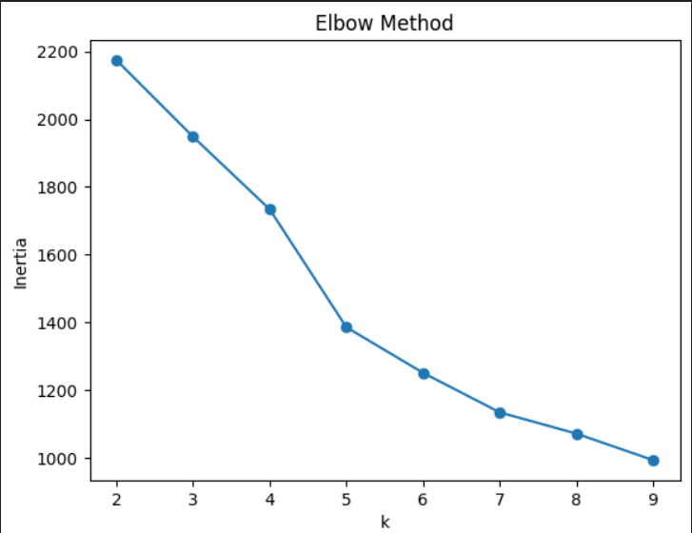
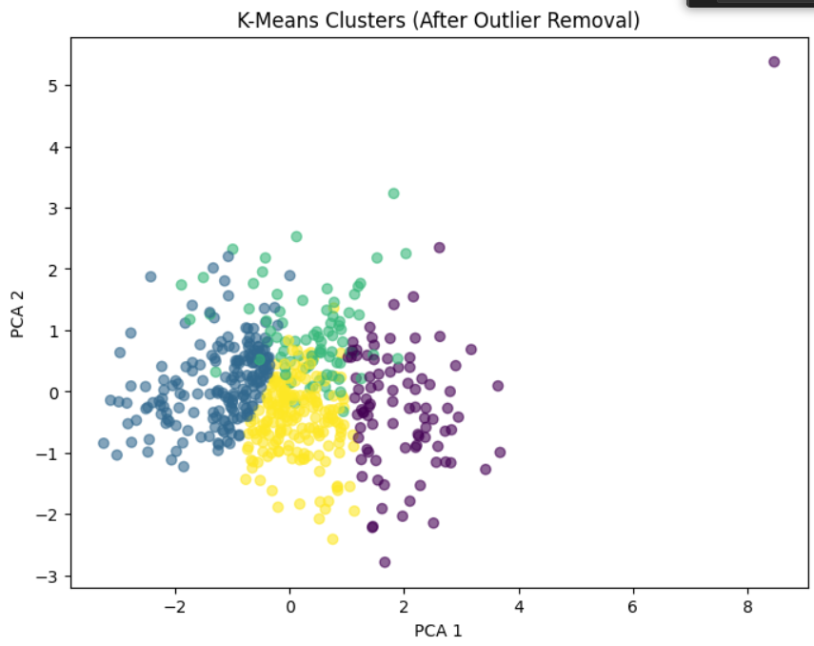
Kmeans Clustering on Vitals signs
#Silhouette Score is max at k=4. score=0.27
Notes:
In this slide, I am showing the clustering results for the vital-sign data using the K-Means algorithm. On the left is the Elbow Method plot, which helps determine the ideal number of clusters. We see a strong bend at k = 4, meaning that after 4 clusters the reduction in inertia slows down, so adding more clusters gives little improvement.
On the right is the PCA visualization of the clusters after removing outliers. PCA reduces the high-dimensional vital-sign data into two components so we can see the clusters visually. Each color represents one cluster. The grouping shows that the data naturally forms around four main patterns.
Even though the silhouette scores for different k values are close, k = 4 provides the best balance between cluster quality and interpretability. Clinically, four clusters also make sense because patient vital-sign patterns tend to fall into a few broad physiological groups.”

Slide 6
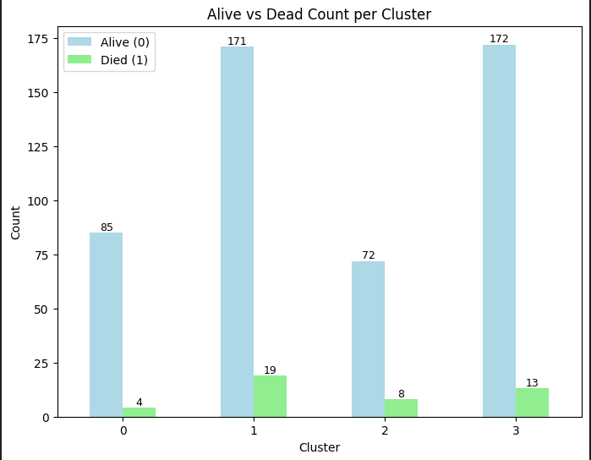
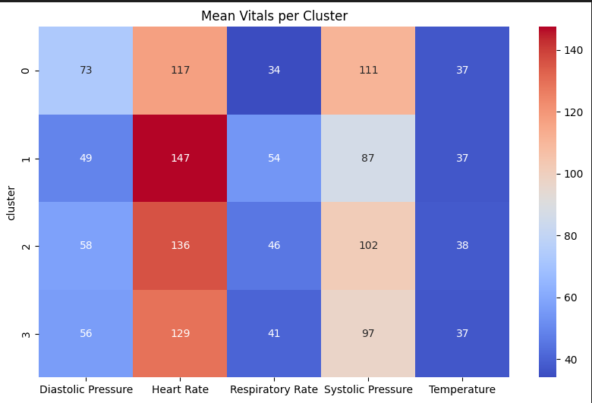
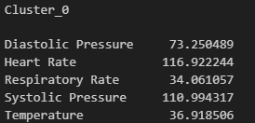
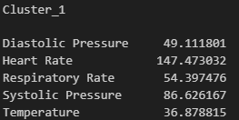
Comparing Clusters
Notes:
Bar Chart (Alive vs Deceased per Cluster)
"This bar chart compares survival outcomes across clusters, highlighting which patient groups have higher mortality risk."
Heatmap (Vital Signs by Cluster)
"This heatmap shows how key vital signs differ by cluster, It helps toidentify the physiological patterns linked to higher mortality."

Slide 7
Cluster | Alive | Dead | Total | Mortality % | Survival % | Interpretation
0 | 85 | 4 | 89 | 4.5% | 95.5% | Lowest-risk cluster; patients show best survival outcomes.
1 | 170 | 19 | 189 | 10.1% | 89.9% | Higher-risk group; mortality more than double Cluster 0.
2 | 72 | 8 | 80 | 10.0% | 90.0% | Higher-risk group similar to Cluster 1; elevated mortality.
3 | 171 | 17 | 188 | 9.0% | 91.0% | Moderate risk; mortality higher than Cluster 0 but lower than Clusters 1–2.
Notes:
Across the four clusters, overall survival remains high, but notable differences emerge when comparing mortality and vital sign patterns. Cluster 0 shows the lowest mortality (4.5%), with relatively stable vital signs and minimal physiologic stress. Cluster 1 demonstrates the highest mortality (10%), driven by the most abnormal vital signs—very high heart rate,elevated respiratory rate, and significantly lower blood pressures—a pattern suggestive of severe systemic stress or early shock. Cluster 2, which also shows 10% mortality, displays elevated HR and RR but with moderately preserved blood pressure. Cluster 3 has an intermediate mortality of 7%, with moderately elevated heart rate and respiratory rate and somewhat lower blood pressure, reflecting a moderate-risk clinical profile.
Overall, as vital signs become more deranged—specifically when HR↑, RR↑, and BP↓—mortality increases, supporting the clinical usefulness of the clustering.

Slide 8
Future Work
Expand the dataset to improve model stability and reduce class imbalance.
Apply SMOTE or reweighting to address mortality class imbalance in clustering.
Test alternative clustering algorithms (e.g., Gaussian Mixture Models, DBSCAN, Agglomerative Clustering).
Incorporate additional clinical variables such as labs and comorbidities to improve cluster interpretability.
Use supervised models (e.g., Random Forest, XGBoost) to link clusters with survival drivers.
.

Slide 9
References
Zeng X, Yu G, Lu Y, Tan L, Wu X, Shi S, et al. PIC, a paediatric-specific intensive care database. Sci Data. (2020) 7(1):14. doi: 10.1038/s41597-020-0355-4
Predictive for patients with Pneumonia in pediatric intensive care unit - file:///C:/Users/w065pxg/AppData/Local/Temp/OneNote/16.0/Exported/%7B2D4404A5-7268-46F0-8460-2D4F509D6C90%7D/NT/9/fped-13-1583573.pdf
Thank you for this opportunity
Notes:
References

